Slide 1
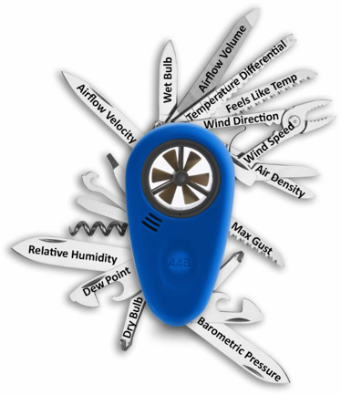
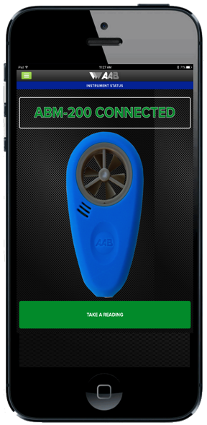
ABM-200 Airflow & Environmental Meter
The Swiss Army Knife of Smartphone Tools
The ABM-200 has all of the features of the ABM-100 plus it’s:
Powerful – The ABM-200 gives a better feature vs cost value ratio than any other tool on the market.
One meter that gives you:
Dry Bulb Temperature
Wet Bulb Temperature
Feels Like Temperature
Temperature Differential
Relative Humidity
Dew Point
Barometric Pressure
Airflow Velocity
Airflow Volume
Air Density
Wind Speed
Wind Direction
Max Gusts

Slide 2

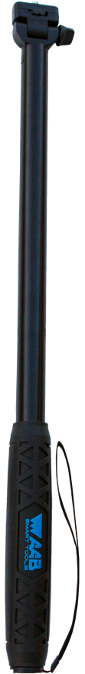

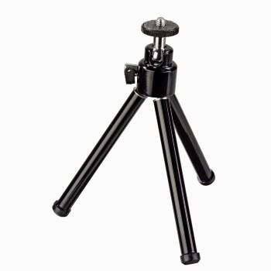
ABM-200 Airflow & Environmental Meter
It’s Wireless
At the requests of ABM-100 owners, we added a Bluetooth Smart radio to the ABM-200.
Increased Safety and Efficiency – The ABM-200 can be placed on our EXP-64 64” extension pole so that the user can spend less time on ladders.
Remote Readings – The ABM-200 can be mounted on a tripod or clipped to a grille so that you can see the temperature improvement during a tune up real-time.

Slide 3

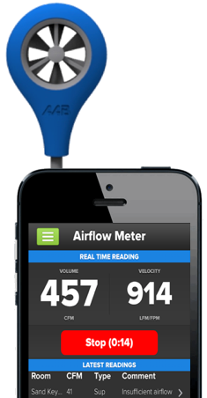
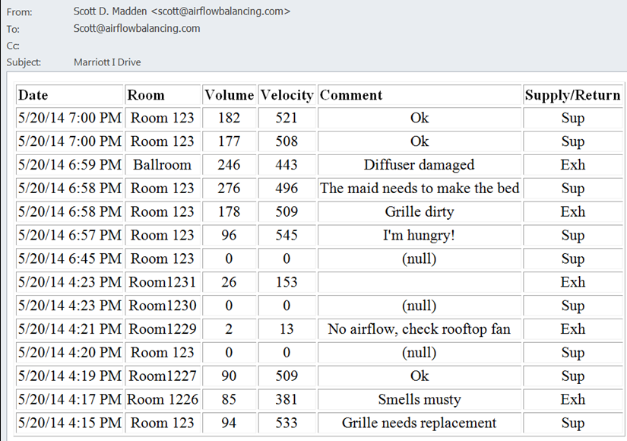
ABM-100 & ABM200 Airflow Report
Notes:
We recommend entering the job or project name in the subject line during the export of the email.
The report is transmitted in a professional looking HTML format that looks great by itself or can be easily copied and pasted into other programs such as Word, Excel, or Powerpoint to provide the opportunity to customize the data or add other items like a company logo to the report.

